Slide 1

IMDb Movie Analysis

Slide 2
Data Exploration
Data set contains 100 rows and 62 columns.
Problem Statement: Finding out insights about the movies and their voters and suggest way to improve.
Based on the problem statement, we should focus on the voters and the genres.

Slide 3
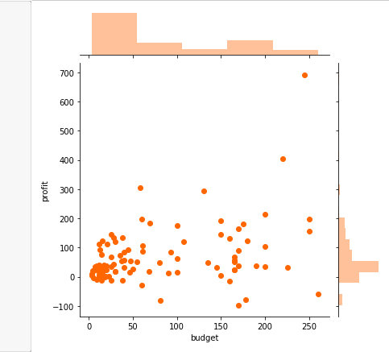
Let's Talk Profit!
Created a column called “Profit”
which contains the difference of gross
and budget.
Plotted a scatter plot between the
columns budget and profit.
Individually inspecting budget and
profit, both are slightly skewed to
right ,which means most of the movies
have positive profit and also budgets
are high.

Slide 4
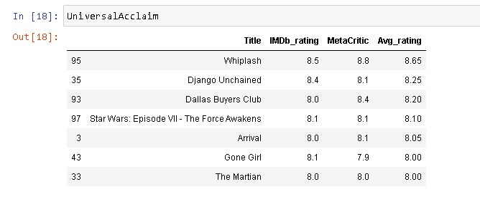
The General Audience and the Critics
Converted the Metacritic column to a scale of 10 and then created a new column called as “Avg_rating” which will have the average of the MetaCritic and IMDbrating.
Retained only the movies with a rating equal to or higher than 8 and stored these movies in a new dataframe “UniversalAcclaim”.

Slide 5
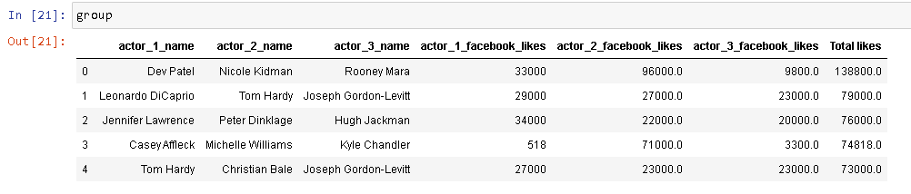
Find the Most Popular Trios - I
Top 5 popular trios

Slide 6
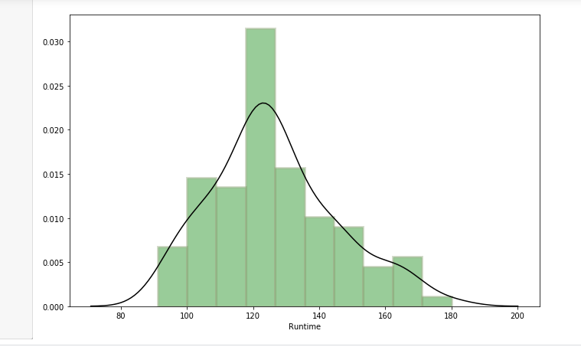
Runtime Analysis
Plotted a distribution plot to
find the
runtime range most of the
movies fall into.
Most of the movies fall within
120–130 minutes of runtime.

Slide 7
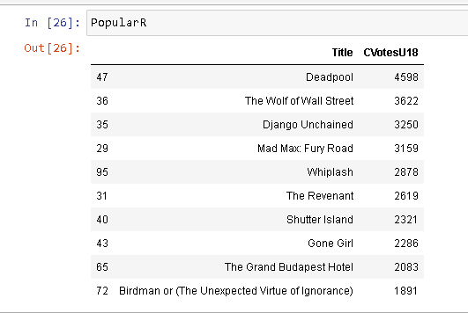
R-Rated Movies
Among all the R rated movies that have been voted by the under-18 age group, top 10 movies that have the highest number of votes

Slide 8
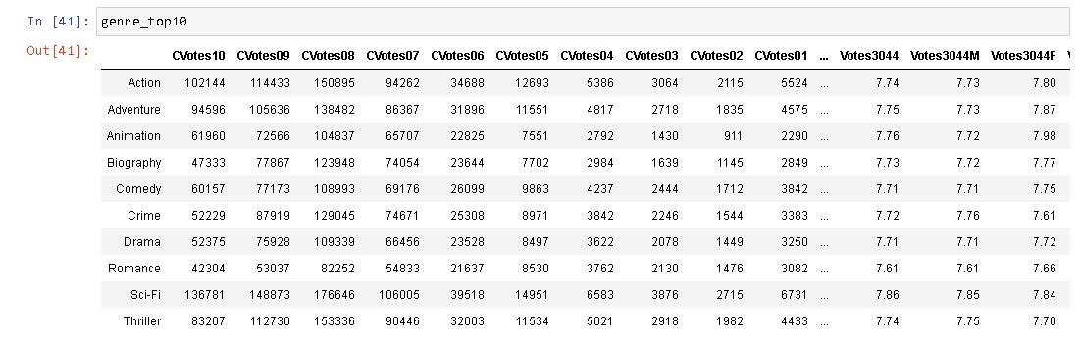
Combine the Dataframe by Genres
Created a new dataframe ”df_by_genre” that contains genre_1, genre_2, and genre_3 and all the columns related to CVotes/Votes.

Slide 9
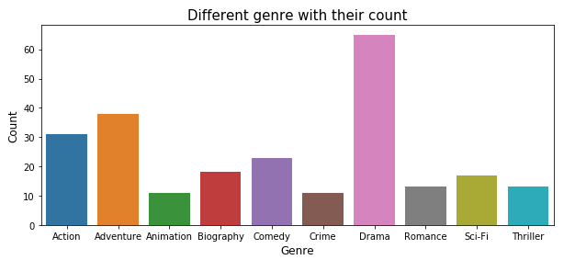
Genre Counts!
Created a column called “cnt” which is count and initialized it to one.
Plotted a bar chart showing different genres vs cnt.
Drama stands at the top whereas Animation is at the bottom.

Slide 10
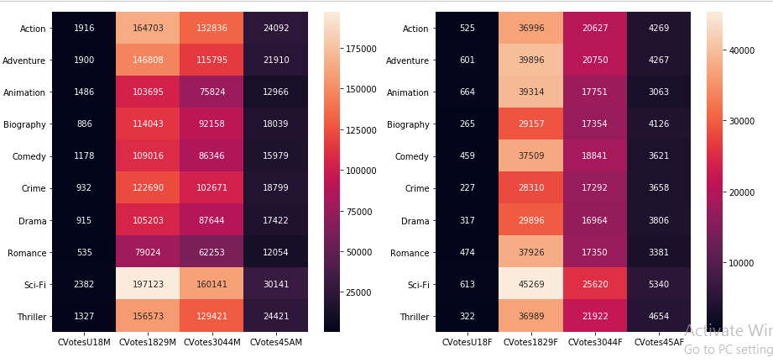
Gender and Genre
Plotted the first heat map to show how the average number of votes of males is varying across the genres.
Age group of 18-29 seems to be the most actively voting for all the genres irrespective of the gender.
Romance is least voted by Male irrespective of their age compared to other genres.

Slide 11
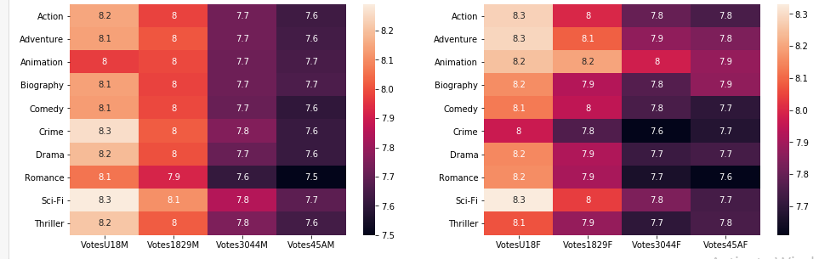
Gender and Genre
Plotted the second heat map to show how the average number of votes of females is varying across the genres.
We can see Animation genres has been voted steadily in Female gender, whereas in the male there is a significant decrease as age increases. It is interesting to observe that females of all age likes animation movies.
After Sci-Fi, males are more interested in watching crime movies whereas women are interested in action movies.

Slide 12
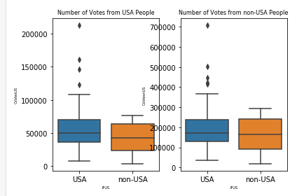
US vs non-US Cross Analysis
Created a column ”IFUS” which contain
the value "USA" if the country of the
movie is "USA". For all other countries
other than the USA, IFUS should contain
the value non-USA.
Plotted a boxplot that shows the
number of votes from the USA people
and non-USA people with the help
of IFUS column.
We can observe the number of votes
on average is more from non-USA
people compared to USA people.
Overall USA movies got a greater
number of votes from both USA and
non-USA people compared to
non-USA movies.

Slide 13
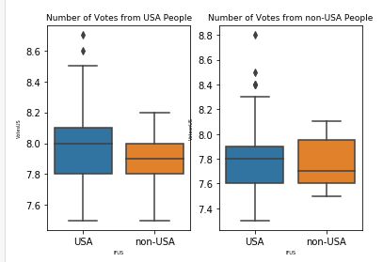
US vs non-US Cross Analysis
Plotted a boxplot that shows the
ratings from the US people and non-USA
people .
Non-US voters have rated both the US
and non-US movies lower as compared
to the US voters, which is evident from
the medians.
Some US movies have got exceptionally
high ratings from both the US and
non-US voters. There are no such
extreme ratings for any of the non-US
movies.
.

Slide 14
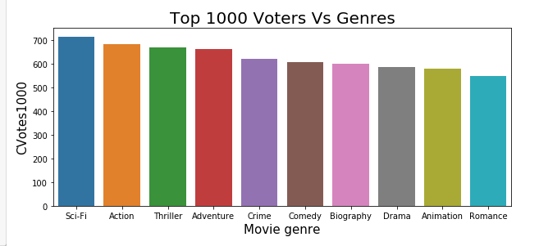
Top 1000 Voters Vs Genres
Plotted a bar chart between the columns CVotes1000 and genre.
Sci-Fi is the most popular amongst the other genres.
There is no much significant difference in popularity amongst Action, Thriller and Adventure.

Slide 15
Recommendations
The profit earned is almost equal to the budget which means most of the movies have positive impact towards the audience.
Half of the movies have the average rating equal to or greater than 8.
As the viewers are much interested in watching movies , the content and the duration of movie should increase because it will help in fetching the profits.
For all the Cvotes/Votes related, Action seems to be at the first place among the top10 genres.
Under 18 age group are interested in R-Rated movies as there are highest number of votes from that age group.
Drama seems to be the most popular genre as it has the highest number of viewers compared to all the other genres.
For Cvotes related, 18-29 age group seems to be most actively voting for any genre irrespective of the gender.
When compared with US and non-USA movies, USA movies got the highest number of votes and ratings as it is clear from the boxplot.
From the data collected for the Top 1000 voters, Sci-Fi seems to be the most viewed genre and the director should focus more on this as it will fetch them profit.

